Slide 1
Introduction to Cell
Introduction of cell
Structure of cell
Cell organelles
By:- Dr. Ravindra Pathre
HOD, Assistant Professor Zoology,
Mss College Ambad

Slide 2
Introduction
Anything having definite boundries called as cell. The study of structure and function of cell called as cell biology..
First dead cell seen by Robert Hooke in bark of wood in 1665 and live cell by Antonevan Leeuwenhoek in 1674.
Cell is structural and functional unit of each organism, individual cell carryout all processes like Glycolysis, TCA, replication transcription etc.
omnis cellulae e cellua All cells are produced from preexisting cells.
All daughter cells will have genetic material eqivalent to parental cell.
Cells are classified into two types on the basis of presence and absence of nucleus. ie.
Prokaryotic cell and Eukaryotic cell

Slide 3
Structure of Prokaryotic cell
It Lacks Membrane bound Nucleus, instead Nucleoid is present. They are unicellular organisms.
Cell wall is made up of peptidoglycan. Flagella for movement and pilli, mesosome and plasmid Cosmid ribosomes are present.
Further prokaryotes divided into two types EUBACTERIA and ARCHEBACTERIA

Slide 4
Structure of Eukaryotic cell
It has well developed nucleus surrounded by Nuclear membrane. Eukaryotes may unicellular or multicellular organisms.
It may have cell wall in plant cell but absent in animal cell
Cell consist organelles like nucleus, E.R., mitochondria, chloroplast, Golgi apparatus, lysosomes etc.

Slide 5
Cell Organelles
Organelles are membrane bound structure that carryout specific activities for cell.
Cell Membrane (Plasma membrane)
Nucleus
Endoplasmic reticulum (ER)
Golgi apparatus
Lysosome
Mitochondria

Slide 6
1. Cell Membrane
The term cell membrane coined by C. Nageli and C. Cramer in 1855.
It is triple layered biological membrane separating the interior of a cell from the outside environment.
Plasma membrane chemically composed by lipids, proteins and Carbohydrates.
It gives structural support to cell and also help in communication, transport ,recognition.
It provide docking sites for various enzymes.

Slide 7
Nucleus
Nucleus is discovered by Robert brown in 1831.
Average diameter of nucleus is 6 $u$m, which occupies around 10% of cell volume.
It is engirdled by a nuclear envelope consist of nuclear pore for for transport.
The membrane distinguishes the cytoplasm from the contents of the nucleus
Nucleus is the genetic control centre of a eukaryotic cell
It stores the cell’s hereditary material or the DNA and carryout its replication.

Slide 8
Endoplasmic reticulum
The endoplasmic reticulum (ER) was discovered by Keith R. Porter and Thomson in 1945.
Endoplasmic Reticulum is a complex network of tubular membranes exclusively present in the cytoplasm of the eukaryotic cell
ER divided into two types on the basis appearance of ribosomes on membrane. Smooth ER is responsible for the synthesis of essential lipids such as phospholipids and cholesterol.
The majority of the functions of rough ER is associated with protein synthesis and protein folding.

Slide 9
Golgi apparatus
Golgi apparatus, also called Golgi complex or Golgi body, membrane-bound organelle of eukaryotic cells and its discovered by Camillo Golgi in 1898.
It is made up of a series of flattened, stacked pouches called cisternae.
The Golgi apparatus is responsible for transporting, modifying, and packaging proteins and lipids into vesicles for delivery to targeted destinations.

Slide 10
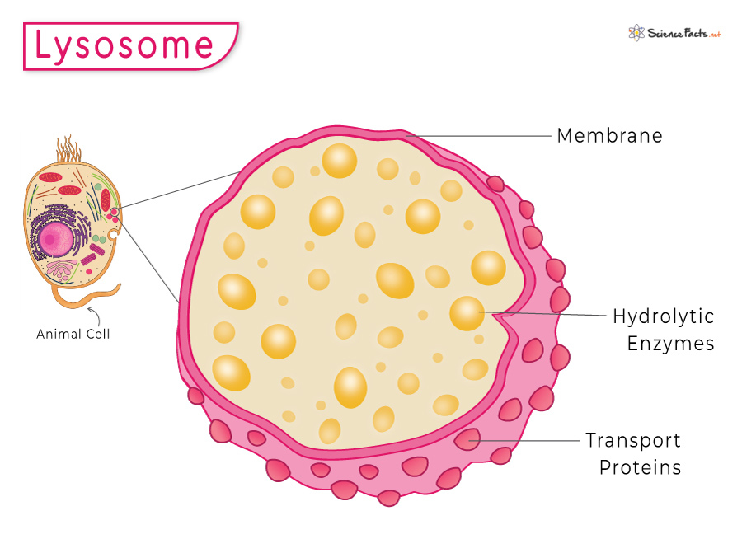
Lysosome
lysosome is a membrane-bound cell organelle that contains digestive enzymes
It was coined by Christian de Duve, a Belgian biologist in 1974.
The pH level of the lumen lies between 4.5 and 5.0, which makes it quite acidic.
The key function of lysosomes is digestion and removal of waste. Cellular debris or foreign particles are pulled in to the cell through the process of endocytosis.
Lysosomes are known as Suicidal Bags as they tend to destroy the cell membrane with its digestive enzymes, causing lysis of the cell called autolysis.

Slide 11
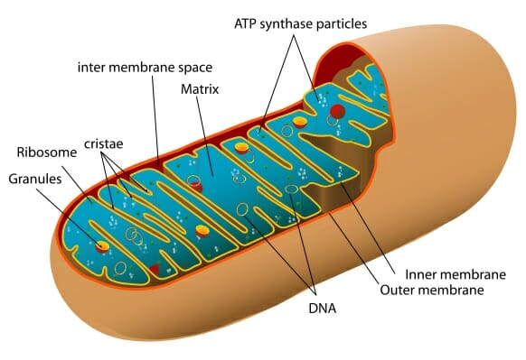
Mitochondria
Mitochondria are membrane-bound organelles present in the cytoplasm of all eukaryotic cells, that produce adenosine triphosphate (ATP), the main energy molecule used by the cell.
The mitochondrion is a double-membraned, rod-shaped structure found in both plant and animal cell. Its size ranges from 0.5 to 1.0 micrometre in diameter.
The structure comprises an outer membrane, an inner membrane, and a gel-like material called the matrix.
The outer membrane and the inner membrane are made of proteins and phospholipid layers separated by the intermembrane space.
The outer membrane covers the surface of the mitochondrion and has a large number of special proteins known as porins

Slide 12
Mitochondria Regulates the metabolic activity of the cell
It Promotes the growth of new cells and cell multiplication and helps in detoxifying ammonia in the liver cells.
It Plays an important role in apoptosis or programmed cell death.
It Responsible for building certain parts of the blood and various hormones like testosterone and oestrogen
It Helps in maintaining an adequate concentration of calcium ions within the compartments of the cell.
It is also involved in various cellular activities like cellular differentiation, cell signalling, cell senescence, controlling the cell cycle and also in cell growth

Slide 13
Thank you

